Slide 1
Ralph J. Bunche Middle School
Principal’s Report
Go Team Meeting
Tuesday, August 30, 2022
6:00 PM-7:00 PM

Slide 2
Go Team Meeting Norms
This is a meeting of the GO Team.
Only members of the team may participate in the discussion.
Any members of the public present are here to quietly observe.
We will be fully present.
We will follow the agenda as noticed to the public and stay on task.
We will be respectful of each other at all times.
We will be open-minded.
We invite and welcome contributions of every member and listen to each other.
We will respect all ideas and assume good intentions.
We will approach differences of opinion with curiosity

Slide 3
Ralph J. Bunche Middle School
Topics:
School Start Update
Current Enrollment & Leveling
School Strategic Plan Overview and SMART Goals
GMAS Results
Q and A

Slide 4
Ralph J. Bunche Middle School
School Start Update
Full Instructional Staff (2nd Spanish Teacher begins in September)
68 Instructional staff
2 instructional coaches, IB and AVID Coordinator
New Art, Band/Orchestra, Chorus, Dance, PE teacher
Recruited from neighboring school districts and other states- MI, Vermont, FL, California
Each grade has an assistant principal, counselor and hall support
Working to fill 4 SWD 1:1 and/or instructional paraprofessionals
# 270 6th graders 264 7th graders 279 8th graders

Slide 5
Ralph J. Bunche Middle School
Enrollment
Project Enrollment | 830
Current Enrollment | 813
Difference | 17 students
Leveling
Leveling is the process the District uses to adjust school budget allocations to match student enrollment.
Budget Impact
Use reserve of $ 116,438 to offset decrease in enrollment and cash in Behavior Specialist vacancy

Slide 6
2021-2025 Strategic Plan

Slide 7
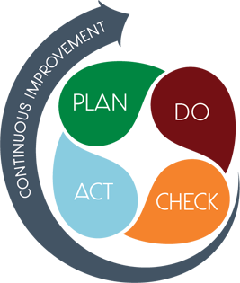
Strategic Plan Smart Goals
Overview
Increase student growth in literacy and numeracy
SMART GOALS
Implementation of the IB curriculum
Implement social and emotional learning programs to develop strong school stakeholders.
Recruit, train and retain effective teaching staff and recruit high quality staff
Implement wellness strategies and resources for staff
Implement Advanced Via Individual Determination Program to individual course determination based on student readiness
At least 30% of students will be proficient or distinguished on the Math milestones by 2022 and a 5% increase each year thereafter.
At least 30% of students will be proficient or distinguished on the ELA milestones by 2022 and a 5% increase each year thereafter.
Retain 80% of our staff over the next five years
Within the next five years continue to strengthen the implementation of our IB program by continuing to meet the IB standards and practices through the collection of artifacts and curriculum implementation that reflect the IB standards and practice requirements.

Slide 8
Ralph J Bunche Middle School
Mission Through rigorous learning experiences, and a challenging international educational program RJBMS will develop 21st century lifelong learners who are competent, caring, and contributing members of a global society prepared for high school and beyond.
Vision Our vision at RJBMS is to enhance and support the development of all stakeholders and provide an educational and professional experience that will increase their love of learning and professional development while creating a rich fertile ground of experiences. We will provide rich educational experiences to both the students and staff to address their unique needs, interests, and strengths as contributing citizens. A member of the RJBMS community is an effective communicator, is socially responsible, a creative problem solver and a self-disciplined contributor to their family and society.
SMART Goals
Within the next five years continue to strengthen the implementation of our IB program by continuing to meet the IB standards and practices through the collection of artifacts and curriculum implementation that reflect the IB standards and practice requirements.
At least 30% of students will be proficient or distinguished on the Math milestones by 2022 and a 5% increase each year thereafter.
At least 30% of students will be proficient or distinguished on the ELA milestones by 2022 and a 5% increase each year thereafter.
Retain 80% of our staff over the next five years
APS Strategic Priorities & Initiatives
School Strategic Priorities 1. .Increase student growth in reading and math 2. Implementation of the IB curriculum 3. Implement social and emotional learning programs to develop strong school stakeholders. 4. Recruit, train and retain effective teaching staff and recruit high quality staff 5. Implement wellness strategies and resources for staff 6. Implement Advanced Via Individual Determination Program to individual course determination based on student readiness | School Strategies
 | 1A. Use a balanced system of assessments to include diagnostic, formative and summative to monitor learning and guide instruction 1B. Identify teachers with the highest growth to pair with students with the greatest need 2A. Implement the IB approach to learning to ensure students develop a range of skills to demonstrate mastery of the standards, think critically, take action, reflect on their learning, participate in IB service projects, 2B. Build teacher instructional capacity through ongoing professional learning led by the IB specialist, implementation of interdisciplinary units and presentations, and fully implement the IB MYP Framework with fidelity
 | 3A.Implement an advisory program and daily advisement course to incorporate SEL, student surveys, trauma informed strategies, and check and connect 3B. Increase student support with small groups led by counselors, graduation coach, social worker, and SEC Disproportionality specialist
 | 4A. Build teacher instructional capacity through ongoing professional learning that provides time and resources for teachers to grow in their knowledge of content, research- based pedagogy, increasing rigor, inquiry-based instruction, IB and AVID, and implementing weekly PLC meetings led by the instructional coaches, PLC leads , teacher leaders and administrators 4B. Provide mentors, support and professional learning for new teachers 4C. Provide the structure, support and opportunities to build the instructional and leadership capacity of our staff 5. Incorporate staff wellness program to include SEL books/articles, surveys, Wellness Room, wellness and fitness challenges and incentives
 | 6A. Establish funding source for teacher trainings and AVID development 6 B. Implement the use of reading, writing and WICOR strategies school wide
Fostering Academic Excellence for All Data
Curriculum & Instruction Signature Program
Building a Culture of Student Support
Whole Child & Intervention Personalized Learning
Equipping & Empowering Leaders & Staff
Strategic Staff Support Equitable Resource Allocation
Creating a System of School Support
Strategic Staff Support
Equitable Resource Allocation
34

Slide 9
Georgia Milestones Assessment Results

Slide 10
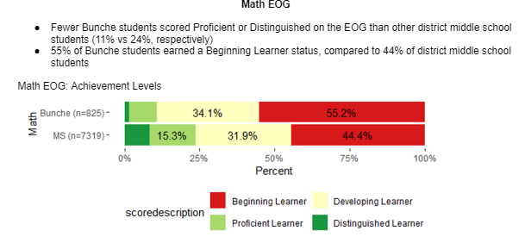
MATH GMAS Results

Slide 11
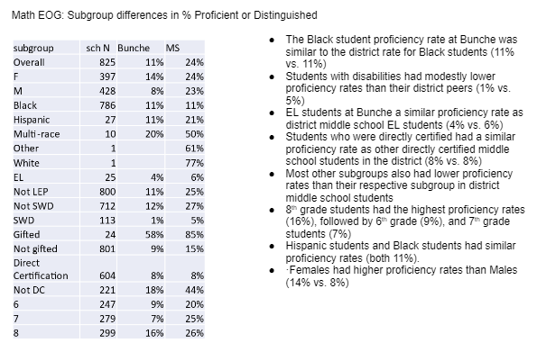
MATH GMAS Results
Algebra I
Fewer than 10 Bunche students took the Algebra I EOC (N=9)

Slide 12
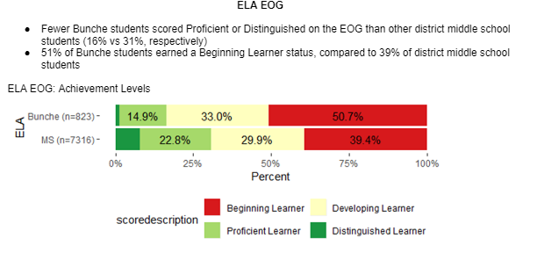
ELA GMAS Results

Slide 13
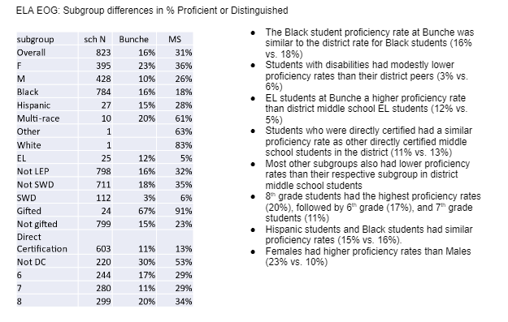
ELA GMAS Results

Slide 14
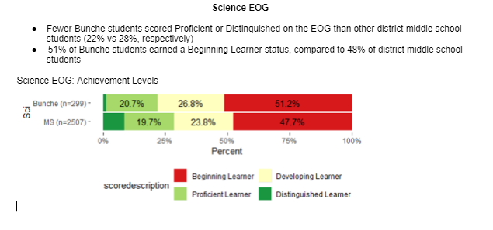
Science GMAS Results

Slide 15
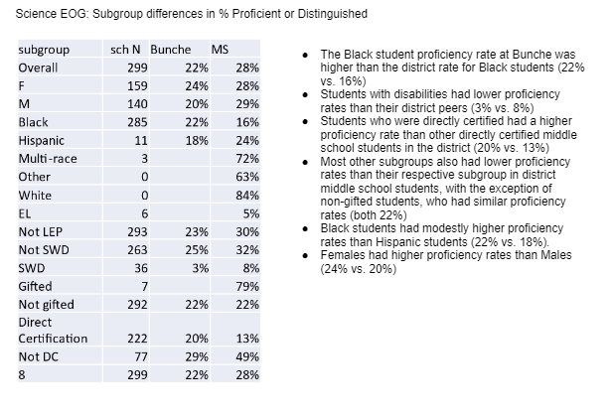
Science GMAS Results

Slide 16
Glows & Grows
Glows
Grows
Began the school year fully staff (principal and teachers)
Math
Black and EL students’ proficiency rate similar to other APS MSs
8th grade students had highest proficiency rate
Females had higher proficiency rate than males
ELA
8th grade students had highest proficiency rate
EL students at BMS had higher proficiency rate than other APS MSs
Female students had higher proficiency rate across all grades
Science
8th grade Black students higher proficiency rate at BMS than other
APS MSs
8th grade females had higher proficiency rate in SC
Increase scores of all and subgroups students
Provide mentoring programs for our students
Engage our male students
Continue to maintain full instructional staff

Slide 17
Questions

